Slide 1
New Presentation
Slide 1

Slide 2
New Presentation
Topic 1
Topic 2
Topic 3

Slide 3
New Presentation
Topic 4
Topic 5
Topic 6

Slide 4
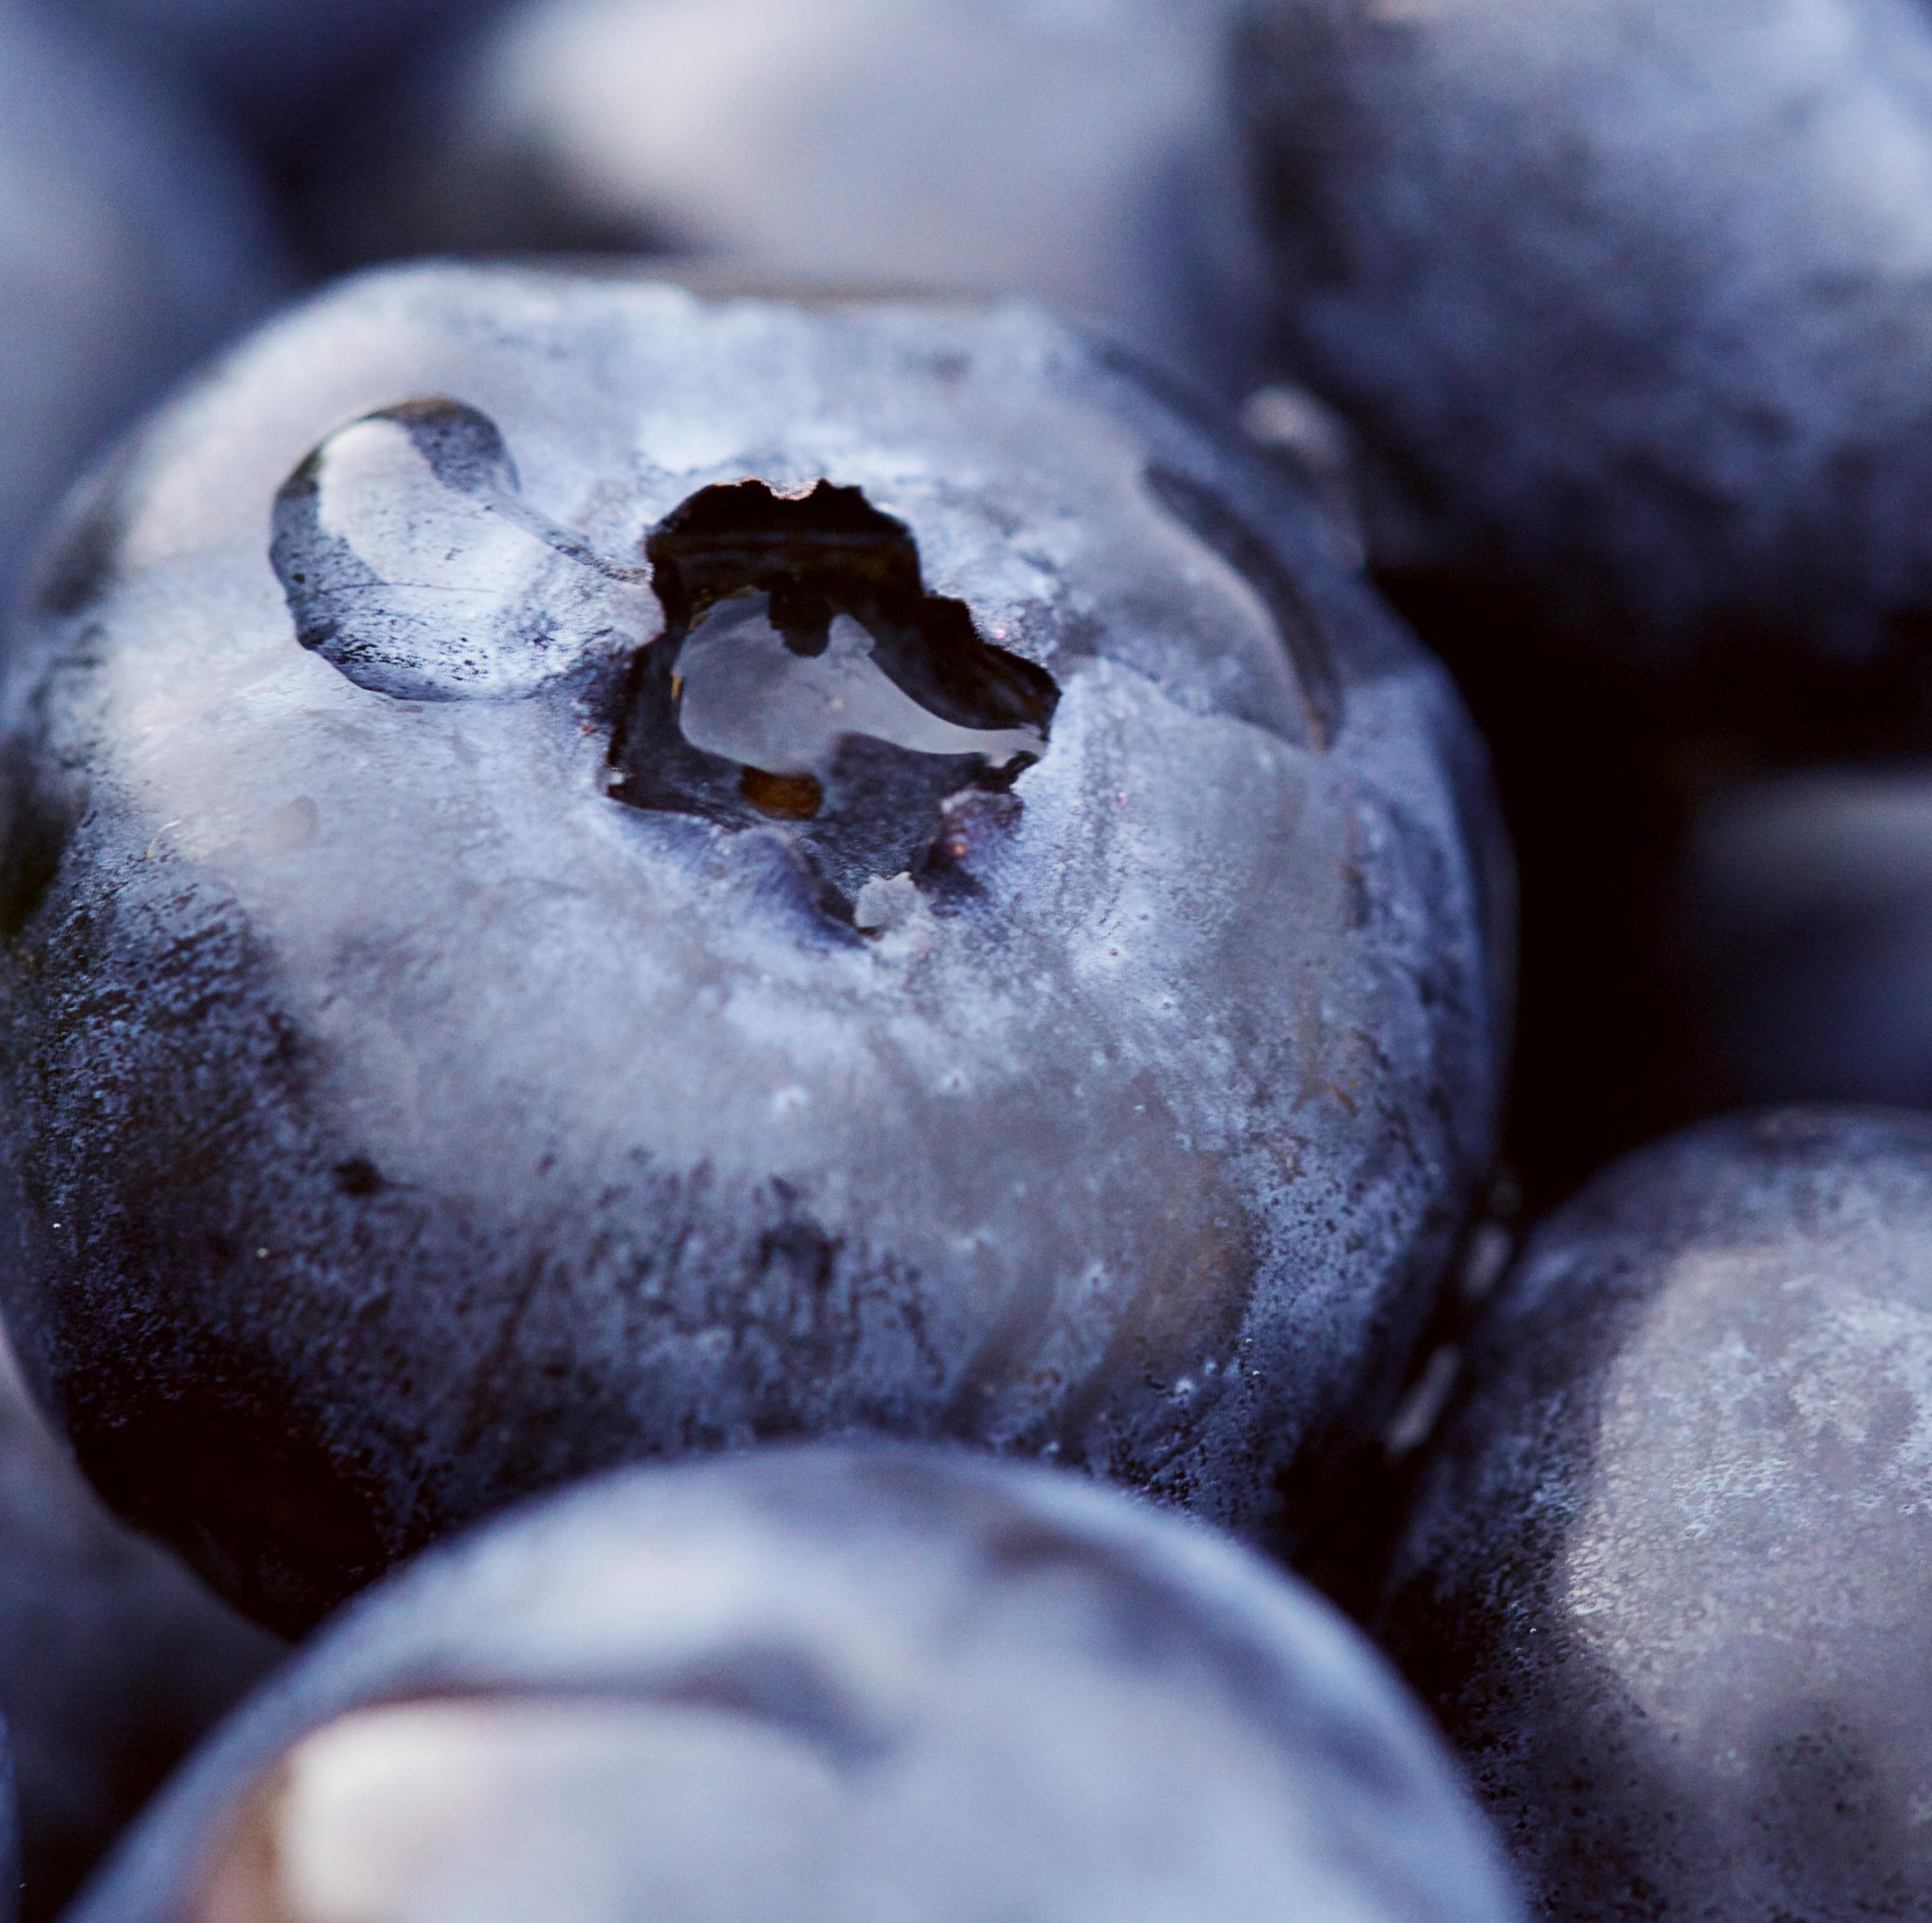
New Presentation
Picking
Baking
Freezing

